Slide 1
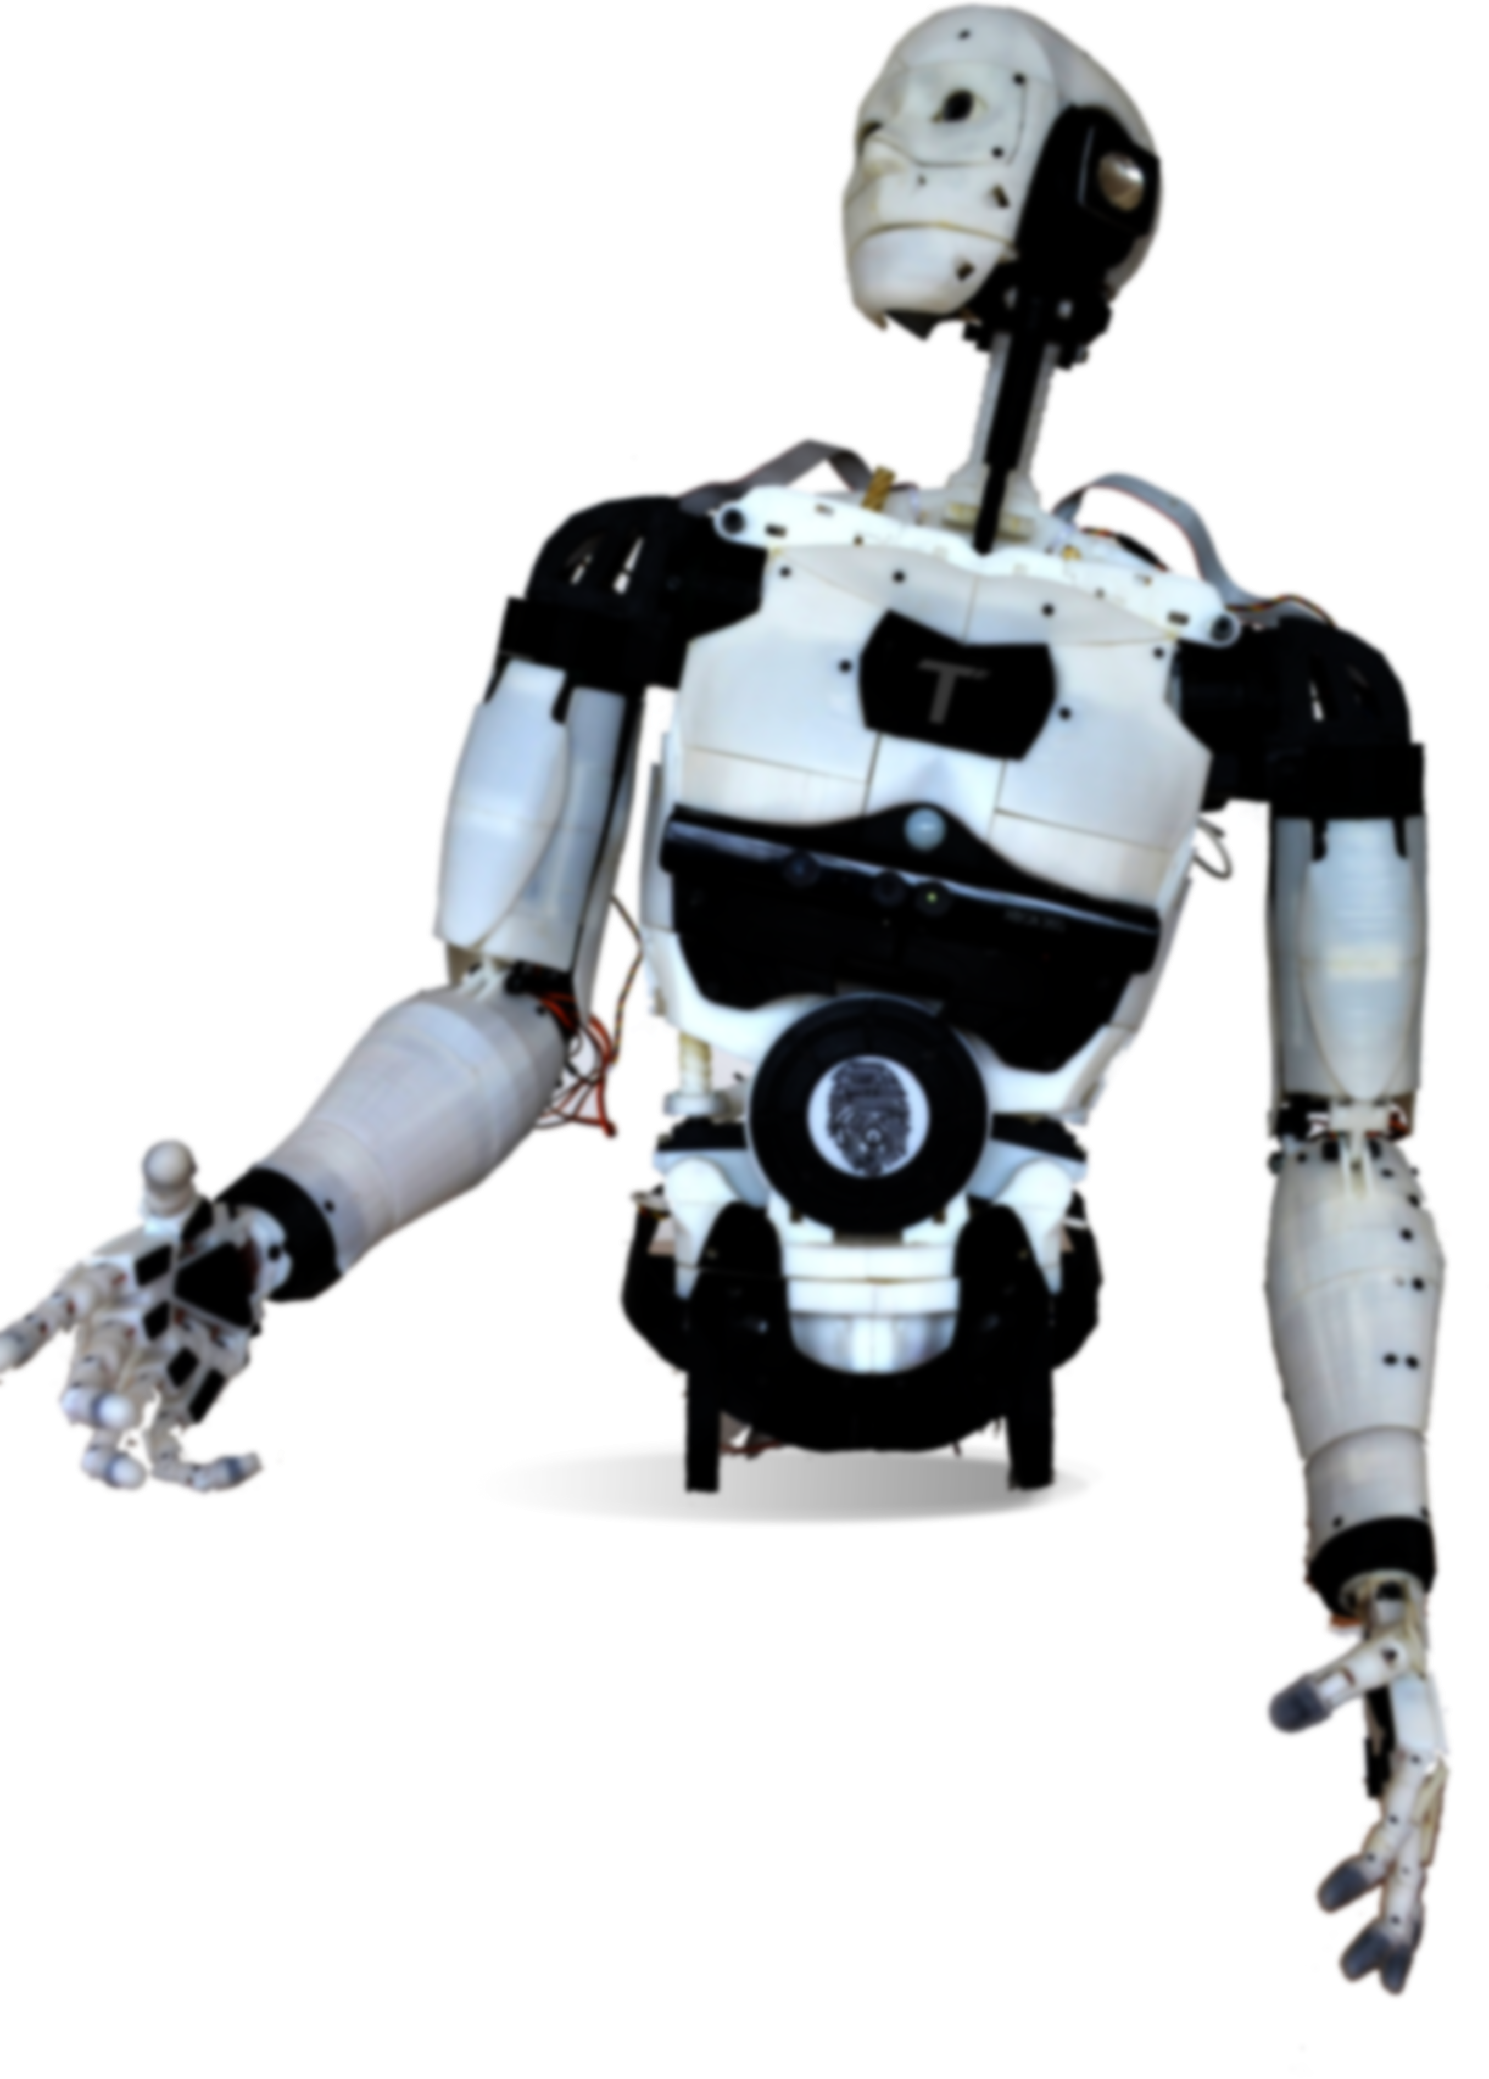
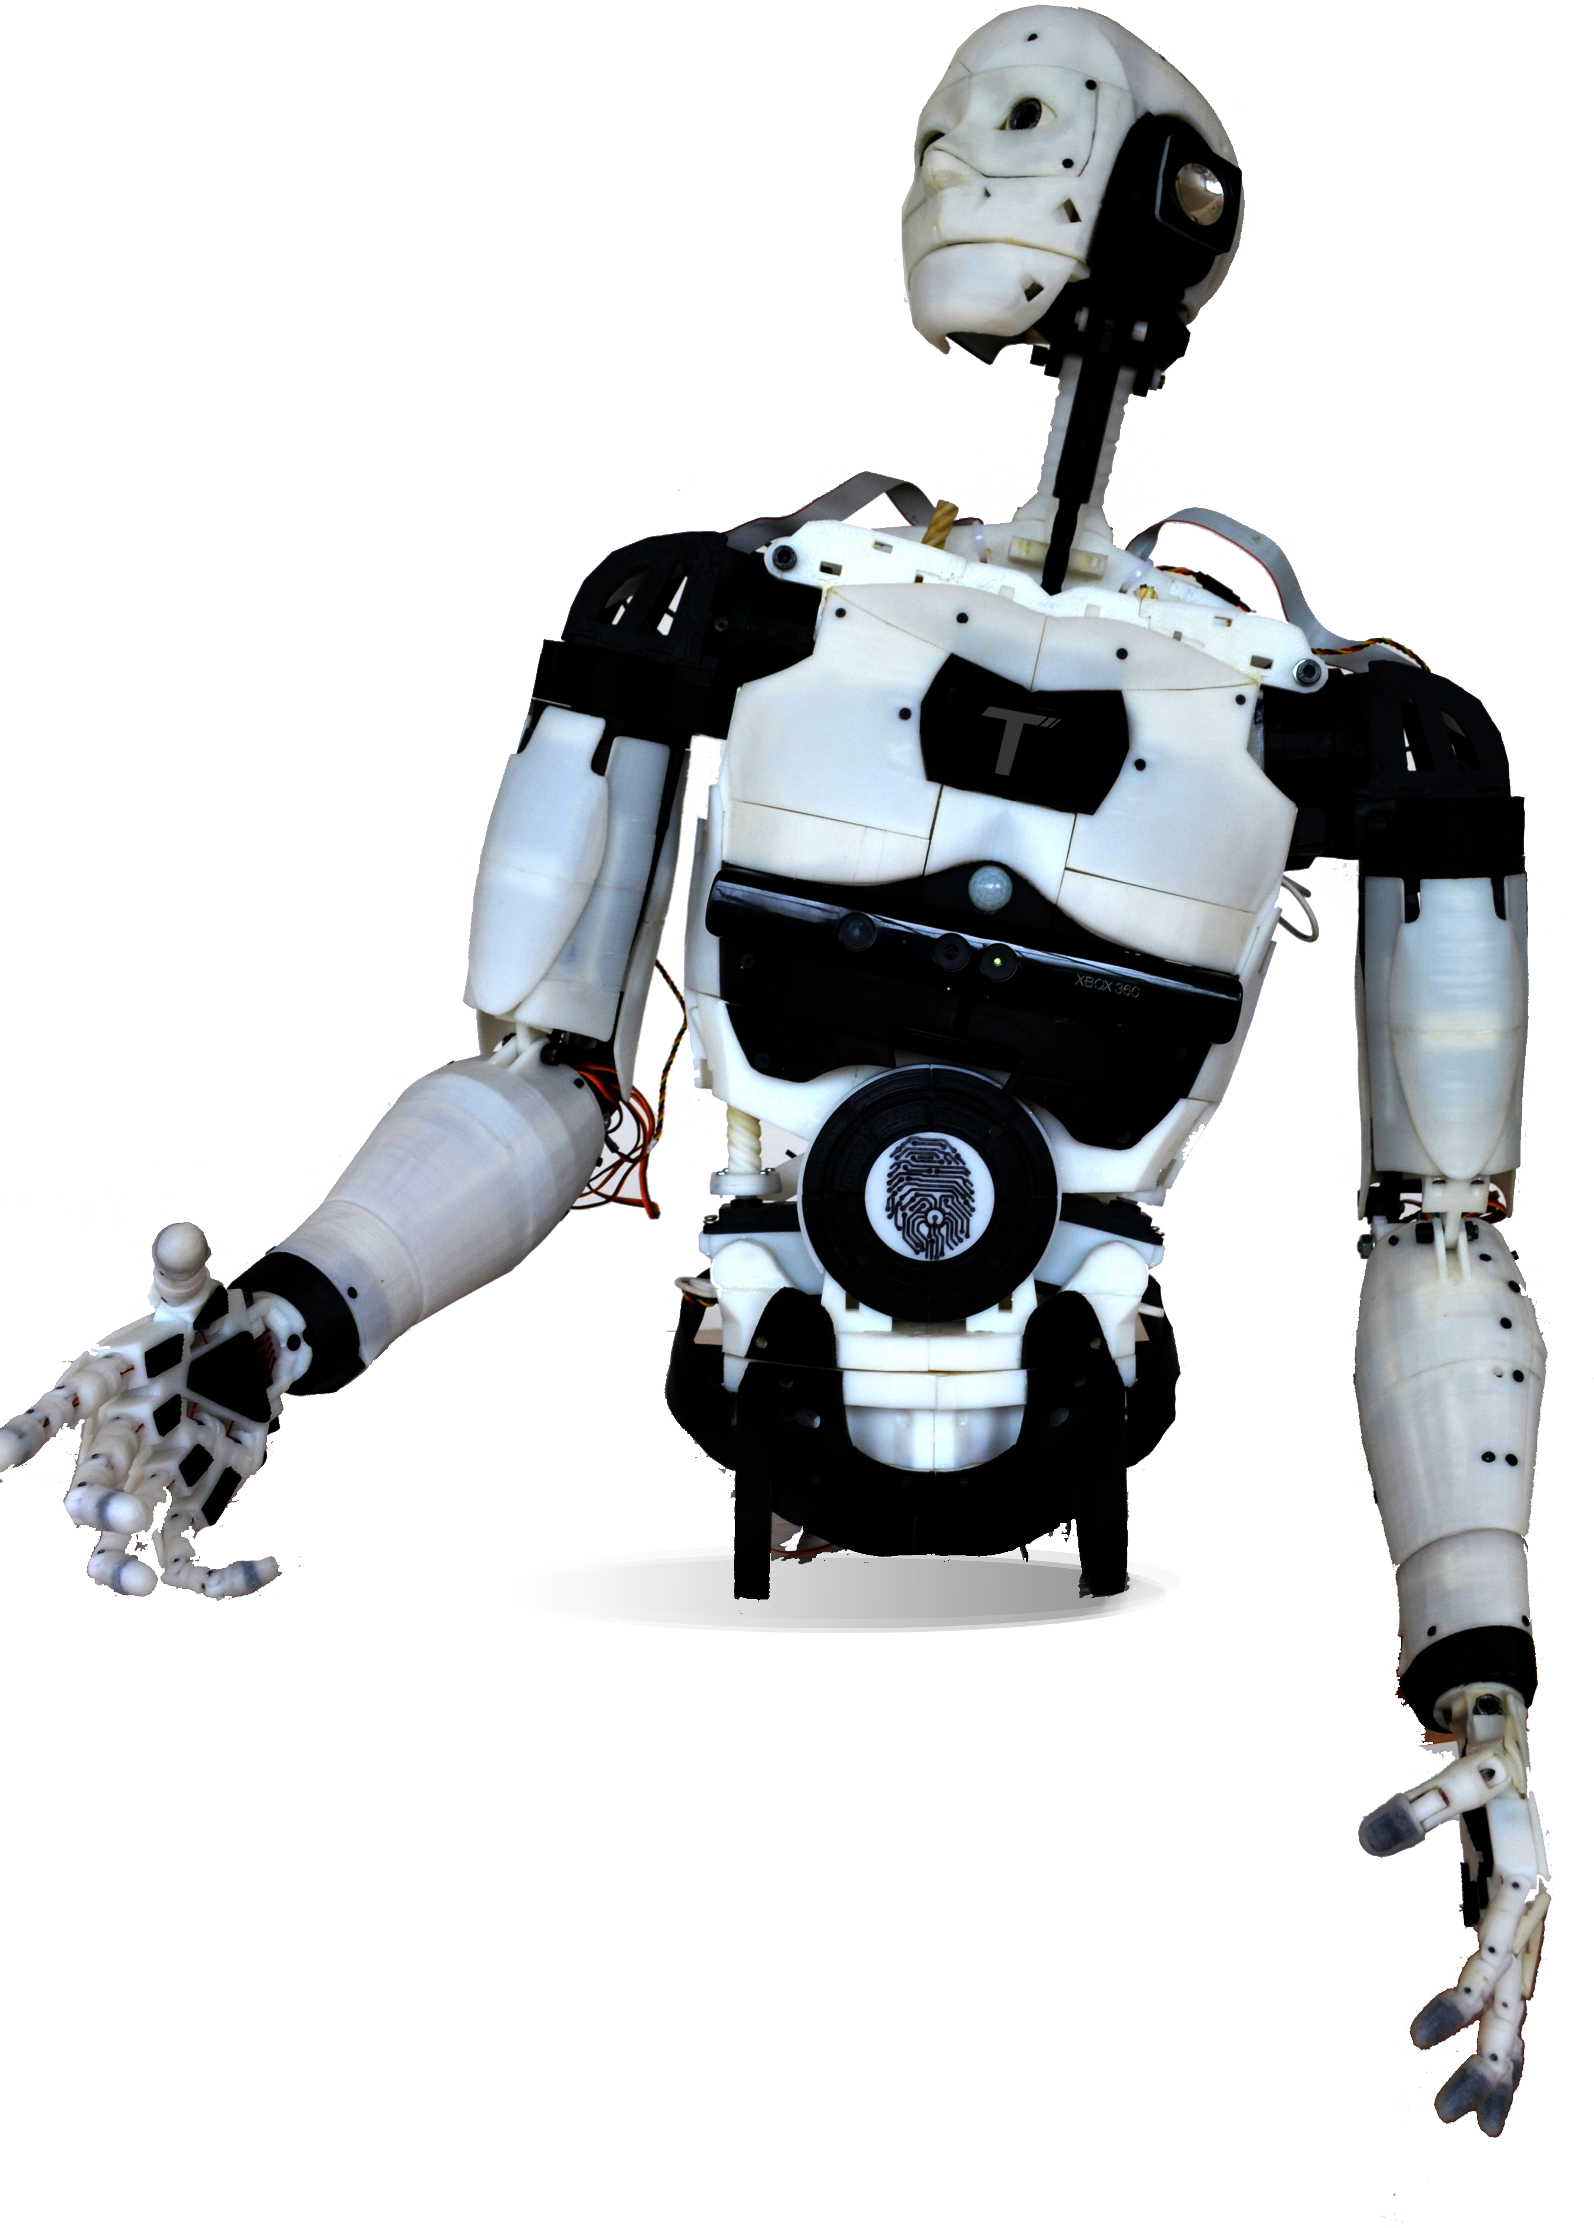
CUZA

Slide 2
01
Proposed Functionalities

Slide 3
Proposed functionalities
Voice Recognition
VR-Based Arm Control
EEG Technology
Cuza has two main vocal functionalities
Uses Inverse Kinematics in a UnityVR Environment
Used to replace physical controllers for moving the robot

Slide 4
Voice Recognition
VR-Based Arm Control
1. Search
Called by using the keyword “Search” and your desired topic. Shortly returns well-structured information about the topic.
2. Translate
Called by using the keyword “Translate”, mentioning the languages to be translated from, and the one to translate to. Returns the translated phrase in the desired language.
Uses a custom environment in UnityVR with integrated Oculus Quest controls, which calculates the arm joints’ positions through Inverse Kinematics.
EEG Technology
The EEG set has 4 electrodes (FP1, FP2, O1, O2), and with their readings we can control the robot’s movements

Slide 5
02
Market Comparisons

Slide 6
CUZA in the current market
After doing research on various humanoid models in circulation, we have come to the following conclusions:
Cuza makes use of its best asset. The EEG.
We are the first in Romania that have made such model.
It keeps up with the versatility of other humanoids.

Slide 7
03
Tech Challenges

Slide 8
Unity.
Inverse Kinematics and Oculus Implementation
There were a handful of problems we encountered along the way.
Problems
Meta Libraries
Unity Limitations
I.K. Formulas

Slide 9
04
Contributions

Slide 10
Contributions
Trifu Andrei-George
Gheorghică-Istrate David
UnityVR, Inverse Kinematics, Poster, Presentation
EEG, Inverse Kinematics, Voice Recognition, Robot Building, Servers

Slide 11
Contributions
Albu Mihnea-Teodor
Albu Mara Sânziana
Beu Robert
Robot Building, 3D Printing
Robot Design, Error managing, PR
Robot building, Servomotor codes

Slide 12
Contributions
Botnaru Victor
Lupu Cezar-Andrei
Robot building, 3D Printing, Inverse Kinematics
Robot building, 3D Printing

Slide 13
05
Project Testing

Slide 14
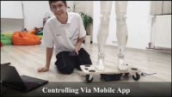

Slide 15
06
Performance Evaluation

Slide 16
07
Future improvements

Slide 17
Future improvements
EMG Implementation
Hydraulic legs
AI and Unity
It is the closest to completion.
To have fully functional legs, we need a different model from the one we currently use.
An AI trained on the data collected from the user performing mundane tasks in a simulated environment.

Slide 18
Thank you for your attention!

